Slide 2
Populations that may benefit from aggressive OSA case finding?
Cardiovascular disease prevention: patient selection and/or effect size?
Cognitive outcomes? Cancer outcomes? Developing
Ventilatory Failure: very high rate of unrecognized disease; very high risk of readmission; preliminary data of effectiveness in some subgroups
  Data (Overlap) [ ] find Paper
Need: characterize comorbidity profiles, what physiologic endotypes are present, and which features predict risk or treatment response.
Notes:
When you’re a hammer everything looks like it needs CPAP
Acetazolamide? Pulmonary Rehab?

Slide 3
Hypercapnia Trajectories
Assessment
2
Assessment 3
Increasing CO2
Assessment 1
Normal CO2 on labs
Normalization of Hypercapnia
Normal CO2 on labs
PaCO2 at discharge (not HCO3), Severity classification are associated with persistence (DOI: 10.1159/000524845)
High PaCO2 and Prior Acute NIV predict recurrence (DOI: 10.1111/resp.12652)
Hypercapnia on labs
Hypercapnia
Hypercapnia on labs
Acute Hypercapnic Respiratory Failure
Recurrent Hypercapnic Respiratory Failure
Chronic Hypercapnia
Acute on Chronic Hypercapnic Respiratory Failure
Common: COPD
Common: OHS
Notes:
Do we know much about the relative proportion of these arrows? No. Probably Recurrent Acute and Acute = over-represented by current methods to identify. Yellow types may be most of what gets diagnosed in sleep clinic (vs hospitalization)
Roughly 30% of OHS patients identified at acute decompensation based on: 83 Priou P, Hamel JF, Person C, et al. Long-term outcome of
noninvasive positive pressure ventilation for obesity hypoventilation
syndrome. Chest 2010; 138: 84–90.
Acute Hypercapnia well tolerated, much research into acute management exists
For COPD – Green vs brick arrows … in HOT-HMV, roughly ¼ of patients who met inclusion criteria at discharge were no longer hypercapnic after 2-4 weeks. Not known how frequently resolution is for other causes
For OHS overall, roughly 50/50 present as the green arrow and the yellow arrow. The green arrow has a much worse prognosis than the yellow arrow.
In UT: more blue and orange arrow than green and yellow because hypoxemia is apparent.

Slide 4
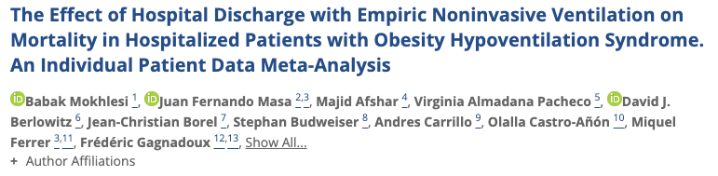
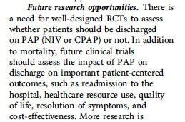
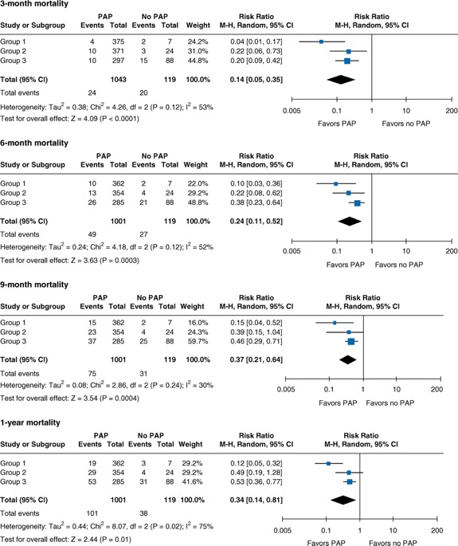
No RCTs have addressed this question
10 observational studies (3 studies of hospitalized cohorts, 6 with hospitalized subgroups); serious risk of bias.
“After adjusting for age, sex, and baseline Pa_{CO2}, the odds ratios (ORs) for [90-day] mortality were significantly lower in the group discharged on PAP (adjusted OR, 0.16; 95% CI, 0.08–0.33)”

Slide 5
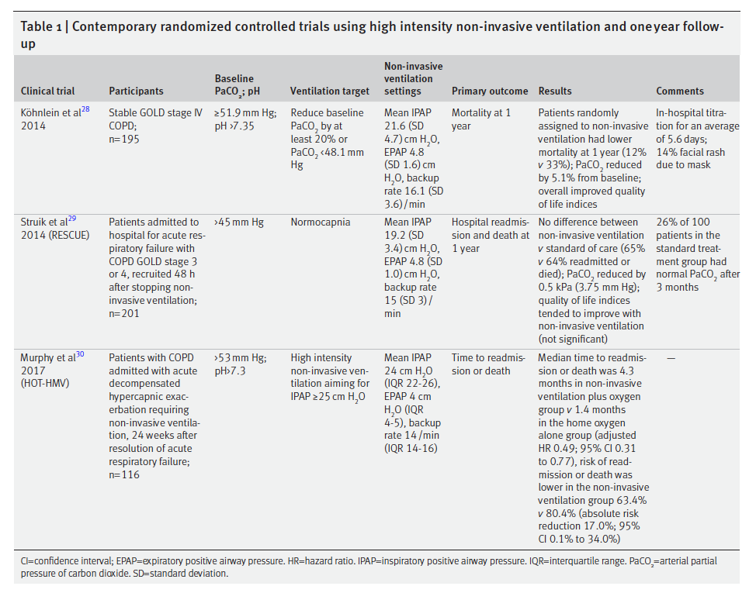
Post-AECOPD trials
Mode: BPAPS/T
Driving pressure
Timing of start after acute exacerbation
  RESCUE vs HOT-HMV
(Not Post Exacerbation)
Many in control resolved hypercapnia
21% excluded at 2-4 weeks.
Notes:
RESCUE, 201 patients with COPD admitted to the hospital with acute hypercapnic respiratory failure who had persistent hypercapnia more than 48 hours after ventilatory support were randomly assigned to NIV or to no NIV.
---> no benefit in primary outcome of resp readmission or death at 12 months (though it did reduce CO2 and improve gas exchange)
--Struik FM, Sprooten RT, Kerstjens HA, Bladder G, Zijnen M, Asin J, Cobben NA, Vonk JM,
Wijkstra PJ. Nocturnal non-invasive ventilation in COPD patients with prolonged
hypercapnia after ventilatory support for acute respiratory failure: a randomised,
controlled, parallel-group study. Thorax 2014; 69: 826-834
HOT-HMV, 116 patients with severe COPD who received NIV during acute hypercapnic respiratory failure and who remained hypercapnic (defined as Pa_{CO2} > 53 mm Hg) 2–4 weeks afterward assigned to HOT + NIV vs HOT alone.
https://pubmed.ncbi.nlm.nih.gov/28528348/

Slide 6
Timing of NIV: COPD vs OHS
“Guidelines for chronic hypercapnic COPD recommend a 2- to 4-week recovery period following hospitalization for COPD exacerbation before assessing for noninvasive ventilation to confirm that chronic hypercapnia is persistent (eg, PaCO₂ ≥ 52 mm Hg)”
  This recommendation is derived from the fact that 21% of patients with COPD recruited for the Home Oxygen Therapy-Home Mechanical Ventilation (HOT-HMV) trial were excluded because the hypercapnia on discharge resolved after 2 to 4 weeks.
Conversely, the guidelines for OHS suggest hospitalized patients with OHS be continued on PAP therapy following hospital discharge until they undergo polysomnography, ideally within the first 3 months of discharge.⁶
  This recommendation is driven by a mortality difference at 3 months postdischarge between patients with OHS discharged without PAP (16.8%) and with PAP (2.3%).¹⁴
Notes:
From:
https://jcsm.aasm.org/doi/10.5664/jcsm.9710
COPD guideline: Macrea M, Oczkowski S, Rochwerg B, et al.. Long-term noninvasive ventilation in chronic stable hypercapnic chronic obstructive pulmonary disease. An official American Thoracic Society clinical practice guideline. Am J Respir Crit Care Med. 2020;202(4):e74–e87.
OHS guideline Mokhlesi B, Masa JF, Brozek JL, et al.. Evaluation and management of obesity hypoventilation syndrome. An official American Thoracic Society clinical practice guideline. Am J Respir Crit Care Med. 2019;200(3):e6–e24.
14: Mokhlesi B, Masa JF, Afshar M, et al.. The effect of hospital discharge with empiric noninvasive ventilation on mortality in hospitalized patients with obesity hypoventilation syndrome. An individual patient data meta-analysis. Ann Am Thorac Soc. 2020;17(5):627–637.

Slide 7
Admitted to hospital (Floor or ICU) with ABG showing PaCO2 over 45 mmHg and pH 7.35-7.45
Collider bias
Notes:
Inclusion criteria: Admitted, 18+
ABG showing PaCO2 over 45 and pH 7.35-7.45 during 2018. N=491
44% had multiple admissions w/n the year
44.2% mortality over a median of 592 days
Manual review of 40 patients with 0 competing metabolic proceses.

Slide 8
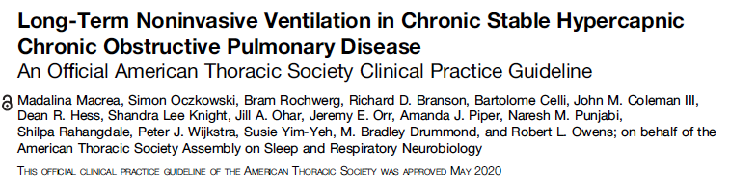
Do NOT start at hospitalization
  wait 2-4 weeks to see if acute on chronic becomes chronic.
In-lab PSG not recommended for pure-COPD; attempt to normalized pCO2.
AVAPS not better than PS
Notes:
NIPPV is now standard of care:
21. Macrea M, Oczkowski S, Rochwerg B, et al. Long-term noninvasive ventilation in chronic stable hypercapnic chronic obstructive pulmonary disease. an official american thoracic society clinical practice guideline. Am J Respir Crit Care Med. 2020;202(4):e74–e87. doi:10.1164/rccm.202006-2382ST
22. Ergan B, Oczkowski S, Rochwerg B, et al. European Respiratory Society guidelines on long-term home non-invasive ventilation for management of COPD. Eur Respir J. 2019;54(3):1901003. doi:10.1183/13993003.01003-2019
23. Murphy PB, Rehal S, Arbane G, et al. Effect of home noninvasive ventilation with oxygen therapy vs oxygen therapy alone on hospital readmission or death after an acute COPD exacerbation: a randomized clinical trial. JAMA. 2017;317(21):2177–2186. doi:10.1001/jama.2017.4451
24. Wilson ME, Dobler CC, Morrow AS, et al. Association of home noninvasive positive pressure ventilation with clinical outcomes in chronic obstructive pulmonary disease: a systematic review and meta-analysis. JAMA. 2020;323(5):455–465. doi:10.1001/ jama.2019.22343

Slide 9
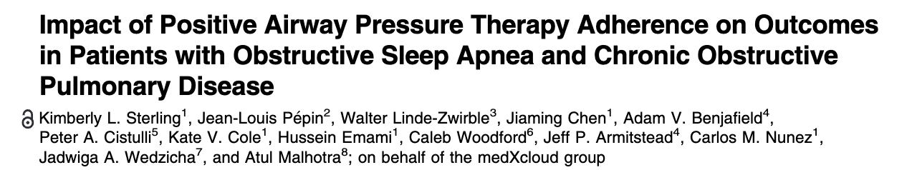
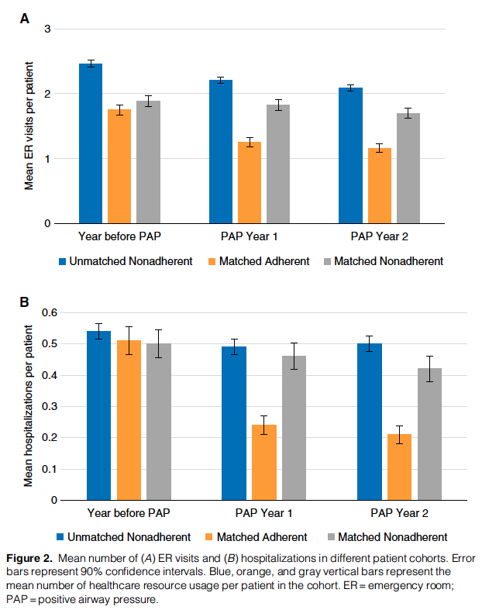
Resmed & Inovalon Insights, LLC payor claims database: 6810 pts with a COPD diagnostic code in the year before device set up
Matching: sex, comorbidities, COPD-related HC usage in prior year
Propensity score for CPAP adherence
Outcomes: ↓ER Visit and Hospitalizations
Critique: healthy adherer bias
Notes:
DOI: 10.1164/rccm.202109-2035OC
Sterling, Pepin, Linde-Zwirble, et al.: PAP Adherence and Outcomes in Overlap Syndrome

Slide 10
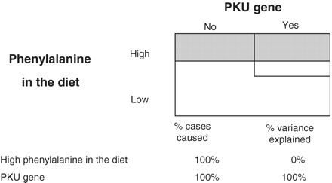
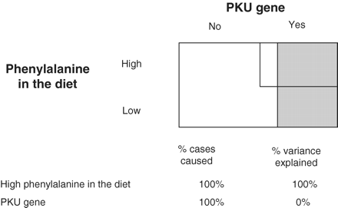
Critique of the Sufficient-Component Model
Consider PKU: Genetic defect causes disease when phenylalinine consumed.
-> in practice, everyone eats phenylalinine: genetic attributable fraction = 100%
-> however, modification of diet avoids development. Thus, if phenylalanine consumption varies then environment contributes
Consider, the hypothetical world where everyone has the PKU gene, but phenylalanine varies (lower diagram) – then, the disease is ALL environmental.
what is the relationship to mendelian randomization?
-> population attributable fraction (and percent variance explained) is not generalizable, and changes as covariates change. Applied to Hypercapnia?
Notes:
https://academic.oup.com/ije/article/40/2/503/733329
“These three examples, one of which approximates the real situation on planet earth and two of which are hypothetical, illustrate that the amount of population variation due to a particular factor can vary wildly between populations (or planets), even though it is an equally important cause in each situation. Once again, the proportion of population variation explained is not generalizable, and is not a valid effect measure”

Slide 11
Consider this as a missing data problem? What is the propensity of p(ABG)?
Could P(ABG) – by provider ideall (or institution) work as an instrument? (to wiggle the likelihood of a diagnosis… could you test that? Are high p(ABG) environments or providers more likely to apply the diagnosis?
[ ] casual inference podcast on instrumental variables.

Slide 12
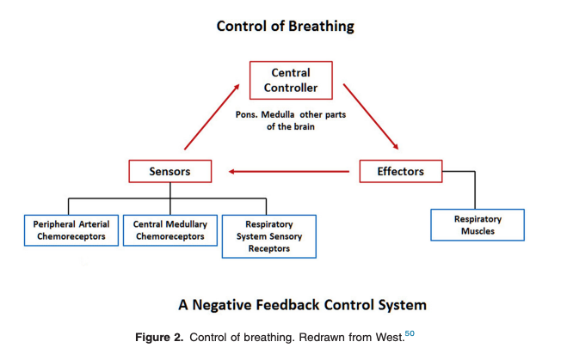
CO2 Homeostasis: Factors Causing Frailty
Decreased Drive to Breathe:
Opiates and other sedatives Brainstem lesions Compensated hypercapnia Sleep Metabolic alkalosis
High ventilatory need:
Increased CO2 Production | Increased Deadspace ‘Wasted Vent’ | Low desired PaCO2
Fever, Infection, or Inflammation Advanced malignancy Muscle activity Seizures Exercise ↑↑ Work of breathing Toxic ingestion Obesity | Anatomic shallow breathing Physiologic Pulmonary embolism Pulmonary hypertension Congestive heart failure Parenchymal lung disease of any kind | Metabolic acidosis Hypoxia
Unable to breathe:
Muscle weakness or inefficiency | Increased respiratory system loads
Neuromuscular disease Lung Hyperinflation Respiratory muscle hypoxia | Elevated airway resistance COPD, Asthma Mucus Upper-airway obstruction Stiff Lungs Parenchymal lung disease Pulmonary edema Stiff Chest Wall Pleural disease Excess or stiff chest wall tissue
Red = OHS, as an example
Notes:
Note: Frailty vs Size of physiologic disturbance.
“Homeostatic capacity” – depending on Ventilatory Reserve and metabolic milieu – a given level of frailty in the respiratory system may result in different levels of dysregulation.
Of note: OHS is a good example here where there are multiple factors in red

Slide 13
Predispositions to Exacerbations
Parabola assumes constant production of CO2 and efficiency of the lung
As Ventilation drops, each further drop causes proportionally more CO2 accumulation.
Analogous to creatinine & GFR
Notes:
Mathetmatically, this is the same reason why a sCr from 1->2 takes a large change in GFR, but from 5-6 is only a small change.
: Metabolic Parabola

Slide 14
Hypercapnia in SLC
P_{A}O₂ = FiO₂ (P_{B}-47)—(PaCO₂/R) → O₂ 17.8 mmHg lower at 4500ft
SpO2 is routinely obtained in clinical practice, PaCO2 (or TcCO2) is not
SLC → earlier identification
Notes:
Hypercapnia is largely iatrogenic: without supplemental oxygen, people with hypercapnia wouldn’t persist – especially if they had concomitant lung disease.
This also makes sense why these people might be so frail and prone to readmission… as your PaCO2 goes up, your buffer goes down. In fact, that’s probably why we’re evolved to hyperventilate with altitude. – called referred to as “ventilatory acclimatization” (92).
Lastly: PaCO2 increases exponentially as VE decreases linearly (think of CO2 clearance and how GFR is much more different th
SpO2 <90% catches people’s attention
Corresponds to a PaO2 of ~55 mmHg (depending exactly on the individual’s oxygen hemoglobin dissociation curve.
Normal A-a gradient? 4 + (0.25 * Age)
Critical PAO2 = paO2 + (Normal A-a gradient)
Critical PAO2 = 51 + 0.25 * Age
PA_{O2} = (P_{atm} – P_{H2O}) * Fi_{O2} – (Pa_{CO2} / RQ) + Fi_{O2} * Pa_{CO2} * (1-RQ)/RQ
PA_{O2} = (650 – 47) * 0.21 – (Pa_{CO2} / 0.8) + 0.21 * Pa_{CO2} * (1-0.8)/0.8
PA_{O2} = 126.63 – (Pa_{CO2} / 0.8) + 0.05 * Pa_{CO2}
PA_{O2} = 126.63 – 1.3 * Pa_{CO2}
At 4500 ft:
PaCO2 = 58.17 - 0.19 * Age
At seal Level:
PaCO2 = 75.95 – 0.19 * Age

Slide 15
Hypotheses: on first (physiologic) principles
Many will have the first time they manifest respiratory frailty during an exacerbation
This group will be at high risk for repeat exacerbations
  Major source of morbidity, mortality, and cost to the system
Interventions to reduce frailty or physiologic stressors may reduce exacerbations
  Better evidence is needed to support these practices to streamline payor funding
If many of these patients are missed during presentation, or proper management is not instituted, this is a lost opportunity.

Slide 16
Cohort Definitions Identified in the Literature
Study | Definition Used | Aim
Thille et al 2017 https://doi.org/10.1007/s00134-017-4998-3 | ICU; pH<7.35 & PaCO2 45+; treated with NIV or IMV; survivors | What is the rate of undiagnosed OSA among survivors?
Ouanes-Besbes et al. 2021, Tunisia PubMed: 33171053 | Admitted to ICU 2015-2018, PaCO2 > 6kpa, pH < 7.35. No prior OSA syndrome diagnosis. | Prev of undx’d OSA
Wilson et al., 2021. USA (Michigan) PubMed: 33951397 | 18+, hospitalized w/ ABG showing CO2 over 45 and pH 7.35-7.45 | Outcomes of compensated hypercap
Cavalot et al 2021, Toronto https://doi.org/10.1080/15412555.2021.1990240 | ABG with pH < 7.35 and PaCO2 > 45 mmHg OR VBG pH 7.34 and PvVO2 > 50 mmHg & presence of respiratory symptoms (CEDIS codes). Exclude CF, NM dz, ILD, thoracic dz, lung ca, CNS dz, Overdose, or trach | 1 yr readmission rate
Adler et al. 2016, Switzerland DOI: 10.1164/rccm.201608-1666OC | Recruited at ICU discharge after surviving: primary admission for Resp failure, PaCO2 over 6.3 kpa and requiring NIV or IMV | What are the comorbidities in survivors?
Meservey et al 2020. USA (Vermont) https://doi.org/10.1007/s00408-019-00300-w | 18 y/o+ admitted (either ICU or floor) with diagnostic code for hypercapnic respiratory failure | What features of patients admitted for hypercapnic respiratory failure predict readmission?
Bulbul et al. 2014. Turkey. doi: 10.4103/1817-1737.128851 | Hospitalized adults with PaCO2 over 45, no acidosis, and breathing room air | What comorbidities occur with inpatient, compensated hypoventilation
Marik 2016. USA (Virginia) DOI: 10.1002/osp4.27 | (i) age 18-90 (ii) a BMI ≥ 40 kg m−2; (iii) a daytime PaCO2 > 45 mmHg and (iv) an admission HCO3 > 28 mEq L−1. Exluded: (i) intrinsic lung disease, (ii) thoracic MSK/NMD (iii) 20+ pack year smoking, COPD | What is the prevalence of undiagnosed Obesity Hypoventilation among hospitalized adults?
Chung et al, AUS, 2021 DOI: https://doi.org/10.1164/rccm.202108-1912LE | Identified by initial ABG PaCO2 over 45, excluded iatrogenic causes/sedation. | What is the population prevalence of hypercapnia from any cause
Vonderbank et al 2020 – Germany https://doi.org/10.2147%2FOAEM.S242075 | All patients with dyspnea or pulm disease admitted to hospital received capillary blood gas (some screening with VBG). Hypercapnia = PaCO2 45 mmHg. | Is hypercapnia predictive of mortality at a specialty hospital?
Notes:
[ ] break down definitions into:
-→ all comers
Investigating OSA/SDB prevalence
Specific Populations
(all comers, SDB prevalence, specific opulations)_
Clinical logic: which diagnoses are relevant, which procedures, medications, and laboratory orders are associated with the phenotype, as well as patient demographic criteria that should be considered
Operation logic: e.g. bridge to how data are recorded in the EHR. - needs ICD x2
Systematic Review methodology: criteria – observational or prospective studies seeking to identify unselected patients with hypercapnia in an inpatient or acute care setting.
Prior Hypercapnic Respiratory Failure Cohorts
Meservey, A. J., Burton, M. C., Priest, J., Teneback, C. C., & Dixon, A. E. (2020). Risk of Readmission and Mortality Following Hospitalization with Hypercapnic Respiratory Failure. Lung, 198(1), 121–134.
Ouanes-Besbes, L., Hammouda, Z., Besbes, S., Nouira, W., Lahmar, M., Ben Abdallah, S., Ouanes, I., Dachraoui, F., & Abroug, F. (2021). Diagnosis of Sleep Apnea Syndrome in the Intensive Care Unit: A Case Series of Survivors of Hypercapnic Respiratory Failure. Annals of the American Thoracic Society, 18(4), 727–729.
Wilson, M. W., Labaki, W. W., & Choi, P. J. (2021). Mortality and Healthcare Use of Patients with Compensated Hypercapnia. Annals of the American Thoracic Society, 18(12), 2027–2032.
Adler, D., Pépin, J. L., Dupuis-Lozeron, E., Espa-Cervena, K., Merlet-Violet, R., Muller, H., Janssens, J. P., & Brochard, L. (2017). Comorbidities and Subgroups of Patients Surviving Severe Acute Hypercapnic Respiratory Failure in the Intensive Care Unit. American journal of respiratory and critical care medicine, 196(2), 200–207.
‘BulBul https://pubmed.ncbi.nlm.nih.gov/24791171/
NOTE: there is no claim that these identify the same patients – but we want to understand how these methods identify prognostically different groups of patients.
Methods: augmented search from ResearchRabbit
[ ] todo: systematic review with
Mesh terms?
Respiratory acidosis - https://www.ncbi.nlm.nih.gov/mesh/68000142
Hypoventilation and subtypes https://www.ncbi.nlm.nih.gov/mesh/68007040
Cohort study
Hypercapnic respiratory failure
Hypercarbic respiratory failure
https://asreview.nl/download/ to review
PUBMED:
And for EMBASE
.......................................................

Slide 17
Gap
Clinical impression suggests that patients admitted with hypercapnia are a clinically heterogenous group, but few multi-center descriptions exist.
  It is not clear if physiologically important subgroups (e.g. high-drive to breathe vs low; ventilatory failure vs hypercapnic respiratory success) can be discriminated on the basis of data elements in the EHR
A variety of methods have been used in prior studies, generally using blood gas-based assessments, diagnostic-codes, procedure codes for ventilation, or some combination of these.
  However, it is not clear if the methods that have used these criteria select similar groups of patients, or if they select representative patients.
    This is a problem for interpreting the meaning of findings
Notes:
[ ] remove this
Issue: Preliminary epidemiologic work suggests hypercapnic respiratory failure is increasingly common, morbid, and expensive to the healthcare system. However, large knowledge gaps remain
Gap: prior literature relies on a variety of methods to identify patients with hypercapnia for inclusion in their studies. If each method identifies different patients, this hampers the interpretability aggregation of results and suggests each individual study may be prone to selection bias.
***expand the point about bias: some investigators say we should study highest risk first. However, the role of a syndrome definition is to define a set of people who respond to treatments (or requirements) in a predictable way – and thus this is really an argument to redefine the syndrome. Analogy of sepsis – but to redefine, first need information on the current practice.
Next step: Computable (EHR) phenotypes are operations defintiions used to identify patients for inclusion in studies. Computable phenotypes with known operating characteristics are needed.
Hypotheses:
Commonly used methods to identify patients with hypercapnic respiratory failure identify different patients; the patients identified by each method differ in characteristics that are likely to influence their clinical outcomes
EHR records contain a variety of types of information that will be expected to improve the classification performance of a computable phenotype, these features will be explorable with a principle component analysis using a “silver standard’ definition of hypercapnic respiratory failure ***PCA to identify which data elements provide maximal information to guide future design
Findings of this principle component analysis can be used to guide a manual chart review labeling of an enriched data-set to generate a usable computable phenotype. (Perhaps a separate manuscript*)

